Slide 1
Analysis of Clickbait in YouTube Videos using Ensemble Models
Second Review
Guide V.Balaji Assistant professor | VISHAL KRISHNAN S H 170071601142 VISHAL R K 170071601143

Slide 2
Literature Review
A Novel Approach for Clickbait Detection - Sarjak Chawda, Aditi Patil, Abhishek Singh, Prof. Ashwini Save
To understand the idea behind the process of clickbait detection.
To get an idea of how clickbait detection is generally done.
A Novel Web Scraping Approach Using the Additional Information Obtained from Web Pages- ERDINÇ UZUN
For scraping of information from the webpages.
Event Driven Web Video Summarization by Tag Localization and Key-Shot Identification-Meng Wang, Richang Hong, Guangda Li, Zheng-Jun Zha, Shuicheng Yan, Tat-Seng Chua
Summarize the video and to describe the events in the video
To reduce the number of features for training

Slide 3
Literature Review
Deep Visual-Semantic Alignments for Generating Image Descriptions-Andrej Karpathy,Li Fei-Fei
To get the description of the thumbnail used for video
To Extract features of the thumbnail that is supposed to represent the video
Long-term Recurrent Convolutional Networks for Visual Recognition and Description-Jeff Donahue, Lisa Anne Hendricks, Marcus Rohrbach, Subhashini Venugopalan, Sergio Guadarrama,Kate Saenko, Trevor Darrell
To get the description of the events that occur in the video
Show and Tell: A Neural Image Caption Generator-Oriol Vinyals, Alexander Toshev, Samy Bengio, Dumitru Erhan
To get the description of the events that occur in the video
To caption the frames of the video

Slide 4
Literature Review
Show, Attend and Tell: Neural Image Caption Generation with Visual Attention- Kelvin Xu, Jimmy Lei Ba, Ryan Kiros, Kyunghyun Cho, Aaron Courville, Ruslan Salakhutdinov, Richard S. Zemel, Yoshua Bengio
To get the description of the events that occur in the video, in a text format for processing
Sequence to Sequence – Video to Text-Subhashini Venugopalan,Marcus Rohrbach,Jeff Donahue,Raymond Mooney ,Trevor Darrell,Kate Saenko
To get the description of the events that occur in the video, in a text format for processing
Clickbait Detection using Multiple Categorization Techniques-Abinash Pujahari and Dilip Singh Sisodia
To understand Clickbaits and Clickbait detection.
To understand the process behind clickbait detection

Slide 5
Literature Review
Mining Disinformation and Fake News: Concepts, Methods, and Recent Advancements-Kai Shu, Suhang Wang, Dongwon Lee, and Huan Liu
To understand Clickbait and Clickbait detection.
To understand the process behind clickbait detection

Slide 6
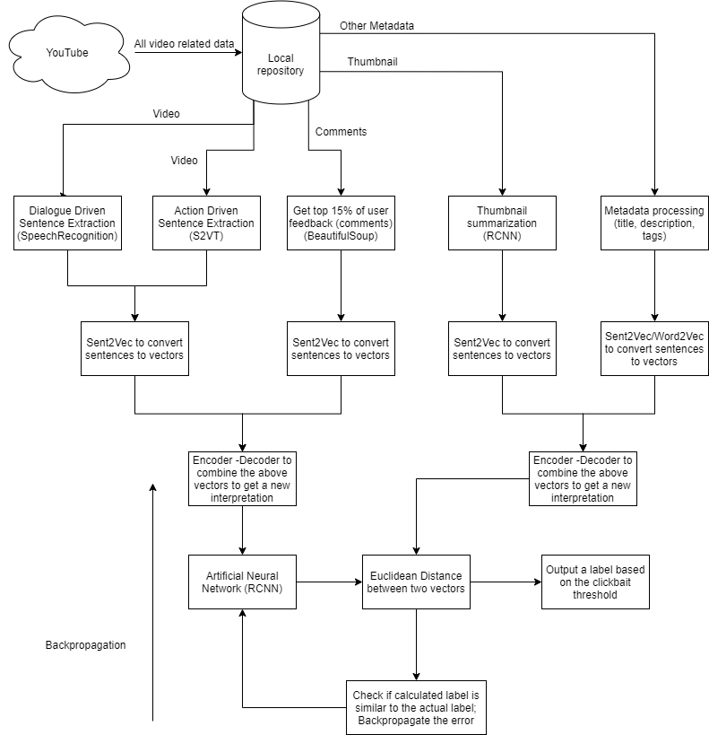
Architecture/Data-Flow Diagram

Slide 7
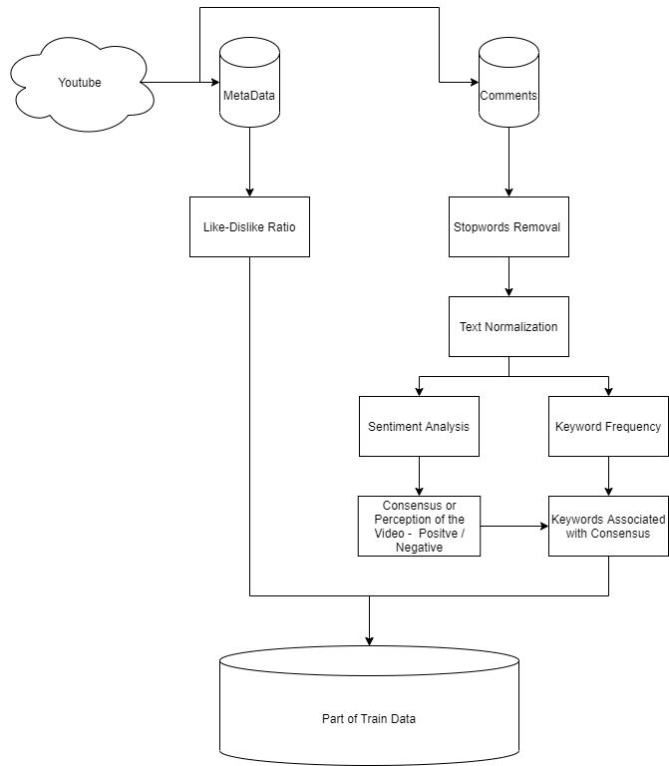
Architecture / Data-Flow Diagram

Slide 8
Modules
Stop words Removal – Using the NLTK package in Python to remove words that are supposed to give structure.
Text Normalization – Normalizing the comments by making them uniform.
Sentiment Analysis – Identifying the emotion the user is trying to express via the comments
Keyword Frequency – Occurrences of each words across all comments
Consensus or Perception of the Video – Compilation of the sentiments of all comments to express the consensus of the video

Slide 9
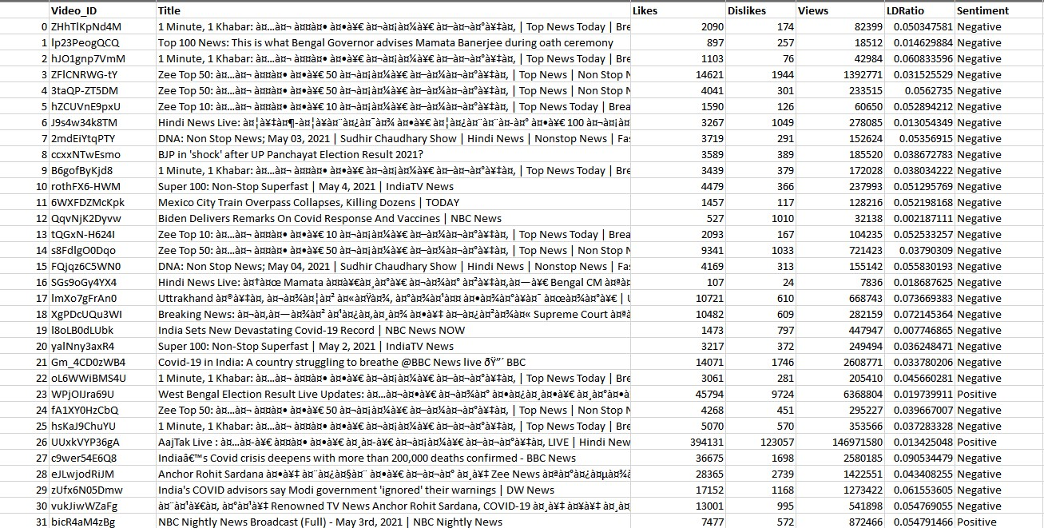
Completed Modules

Slide 10
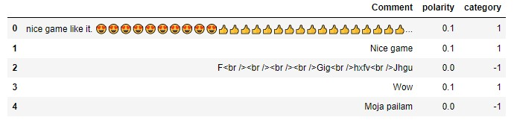
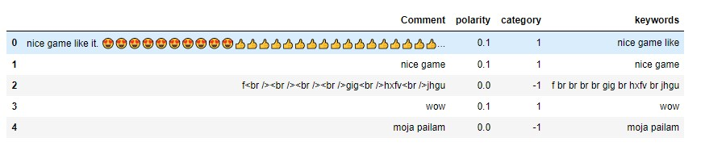
Completed Modules

Slide 11
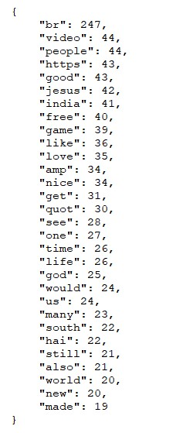
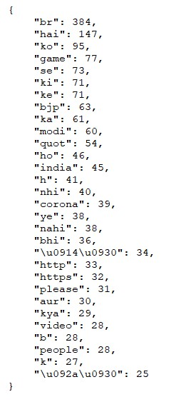
Completed Modules

Slide 12
Project Plan
Thumbnail Caption Extraction – Get the thumbnail of each video and use image captioning mechanism to extract features from the thumbnail
Transcript of the Video – Apply speech to text modules on the video’s audio to get the transcript of the video for processing
Compile the data , prepare and train the neural network.
Limitations and Challenges
Captioning frames of the video is not feasible due to the lack of technology
Variety of the results suggests that different models to be developed for different categories.

Slide 13
THANK YOU

